Slide 1
Optimization

Slide 2
Optimization Illustration 1
Cycle Trends is introducing two new lightweight bicycle frames, the Deluxe and the Professional, to be made from aluminum and steel alloys. The anticipated unit profits are $10 for the Deluxe and $15 for the Professional.
The number of pounds of each alloy needed per frame is summarized below. A supplier delivers 100 pounds of the aluminum alloy and 80 pounds of the steel alloy weekly. How many Deluxe and Professional frames should Cycle Trends produce each week?
(Pounds of Alloy)Aluminum Alloy Steel Alloy
Deluxe 2 3
Professional 4 2

Slide 3
Optimization Illustration 2
The Sureset Concrete Company produces concrete. Two ingredients in concrete are sand (costs $6 per ton) and gravel (costs $8 per ton). Sand and gravel together must make up exactly 75% of the weight of the concrete. Also, no more than 40% of the concrete can be sand and at least 30% of the concrete be gravel. Each day 2000 tons of concrete are produced. To minimize costs, how many tons of gravel and sand should be purchased each day?

Slide 4
Optimization: A Maximization Problem
Max 5x₁ + 7x₂
s.t. x₁ < 6
2x₁ + 3x₂ < 19
x₁ + x₂ < 8
x₁, x₂ > 0

Slide 5
Graphical Solution
Constraint #1 Graphed
x₂
8
7
6
5
4
3
2
1
1 2 3 4 5 6 7 8 9 10
x₁ < 6
(6, 0)
x₁

Slide 6
Graphical Solution
Constraint #2 Graphed
x₂
8
7
6
5
4
3
2
1
1 2 3 4 5 6 7 8 9 10
(0, 6 1/3)
2x₁ + 3x₂ < 19
(9 1/2, 0)
x₁

Slide 7
Graphical Solution
Constraint #3 Graphed
x₂
(0, 8)
8
7
6
5
4
3
2
1
1 2 3 4 5 6 7 8 9 10
x₁ + x₂ < 8
(8, 0)
x₁

Slide 8
Graphical Solution
Combined-Constraint Graph
x₂
x₁ + x₂ < 8
8
7
6
5
4
3
2
1
1 2 3 4 5 6 7 8 9 10
x₁ < 6
2x₁ + 3x₂ < 19
x₁

Slide 9
Graphical Solution
Feasible Solution Region
x₂
8
7
6
5
4
3
2
1
1 2 3 4 5 6 7 8 9 10
Feasible
Region
x₁

Slide 10
Graphical Solution
Objective Function Line
x₂
8
7
6
5
4
3
2
1
1 2 3 4 5 6 7 8 9 10
(0, 5)
Objective Function
5x₁ + 7x₂ = 35
(7, 0)
x₁

Slide 11
Graphical Solution
Optimal Solution
x₂
Objective Function
5x₁ + 7x₂ = 46
8
7
6
5
4
3
2
1
1 2 3 4 5 6 7 8 9 10
Optimal Solution
(x₁ = 5, x₂ = 3)
x₁

Slide 12
Optimization
In real world problems, optimization is a process of making something as good or effective as possible. This process involves choosing inputs that give the best or desired output.
Example :
Choosing optimum location of warehouse to reduce shipment time
Designing a bridge that can carry maximum possible/desired load
Selecting stocks that will create maximum returns

Slide 13
Optimization
In mathematics, optimization is a process of optimizing i.e. maximizing or minimizing a function of one or more variables on a given domain. Here the function to be optimized is called an objective function which is a quantitative measure of performance.
For example: to maximize profits, minimize time, minimize
costs, maximize sales are some optimization problems in day
to day life
Cost function or loss function are some frequently used terms for objective function used in machine learning. The input parameters to the cost function are called decision/design variables.

Slide 14
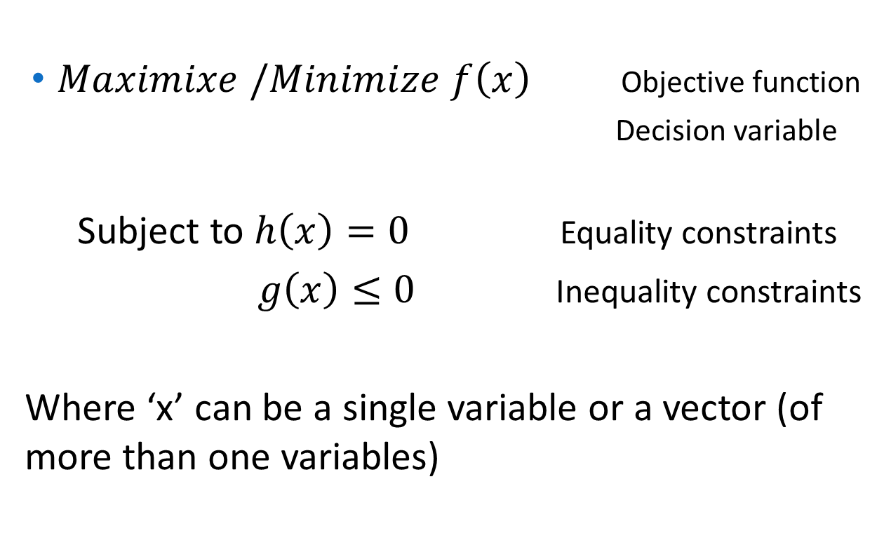
Mathematical formulation of optimization problem:
$Maximixe /Minimize$ $f\left(x\right)$ Objective function
Decision variable
Subject to $h\left(x\right)=0$ Equality constraints
$g\left(x\right)≤0$ Inequality constraints
Where ‘x’ can be a single variable or a vector (of more than one variables)

Slide 15
Types of Optimization:
Optimization problems can be classified into various categories based on nature of objective function, decision variables and constraints , physical structure of the problem etc.
Few important classifications are:
Constrained Vs. unconstrained optimization
If there are one or more constraints on decision variables then it is constrained optimization problem
In case there are no constraints then it is unconstrained optimization.

Slide 16
Types of Optimization:
Linear Vs. Non-linear Optimization
If the objective function and all the constraints are linear functions of decision variables then the optimization problem is called linear programming problem(LPP)
Otherwise it is called non linear programming problem (NLP)
Discrete Vs. Continuous optimization
If some or all the decision variables are restricted to take only integer values then the optimization problem is called integer programming problem or discrete optimization
Otherwise it is called continuous optimization where the decision variables take continuous set of values.

Slide 17
Types of Optimization
Deterministic Vs. Stochastic Optimization:
In deterministic optimization, it is assumed that the data for the given problem are known accurately. However, for many actual problems, the data cannot be known accurately for a variety of reasons.
The first reason is due to simple measurement error.
The second and more fundamental reason is that some data represent information about the future (e. g., product demand or price for a future time period) and simply cannot be known with certainty.
In stochastic optimization, the uncertainty is incorporated into the model.

Slide 18
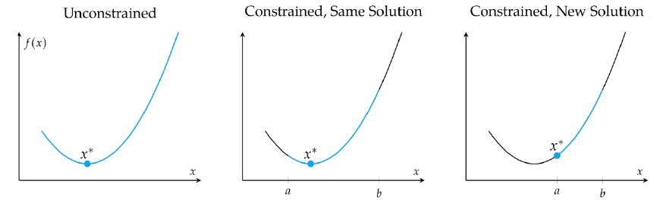
Constrained Optimization
Maximize or Minimize a function 𝑓(𝑋), 𝑋 ∈ 𝑅𝑛 subject to constraints on 𝑥.
Constraints can be equality constraints or inequality constraints.
It restricts the vector 𝑋 to a desired set of values
Solution might differ from corresponding unconstrained optimization problem
We are likely to get local maxima/minima instead of global maxima/minima in unconstrained optimization.

Slide 19
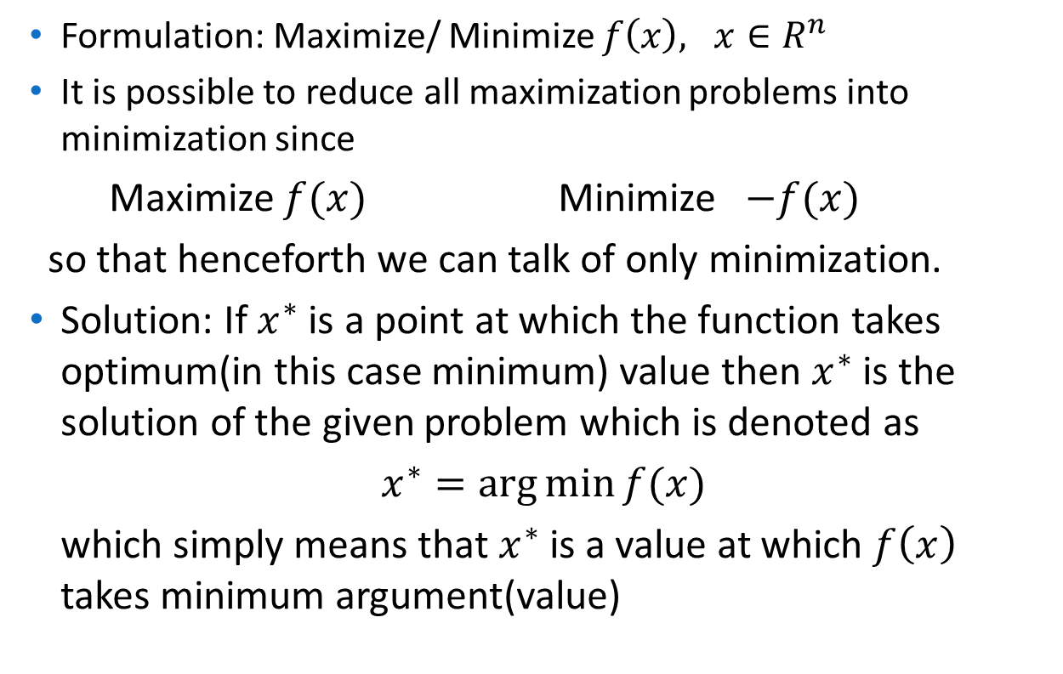
Unconstrained Optimization
Formulation: Maximize/ Minimize $f\left(x\right),$ $x∈R^{n}$
It is possible to reduce all maximization problems into minimization since
Maximize $f(x)$ Minimize $−f(x)$
so that henceforth we can talk of only minimization.
Solution: If $x^{∗}$ is a point at which the function takes optimum(in this case minimum) value then $x^{∗}$ is the solution of the given problem which is denoted as
$x^{∗}=\arg{\min{f(x)}}$
which simply means that $x^{∗}$ is a value at which $f\left(x\right)$ takes minimum argument(value)

Slide 20
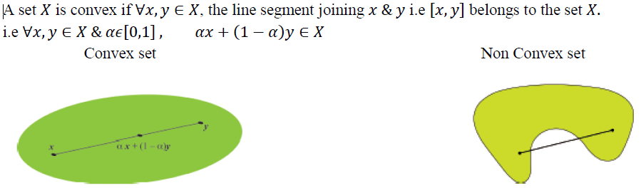
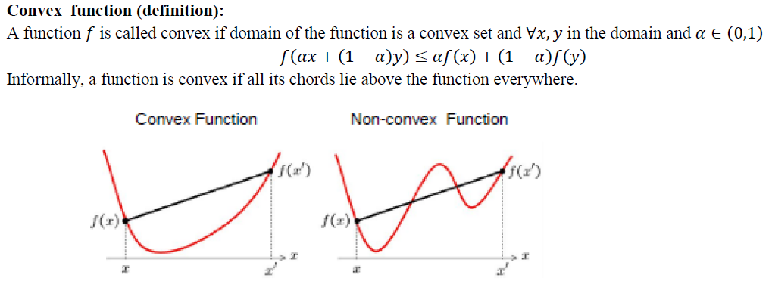
Convex Sets & Convex Functions

Slide 21
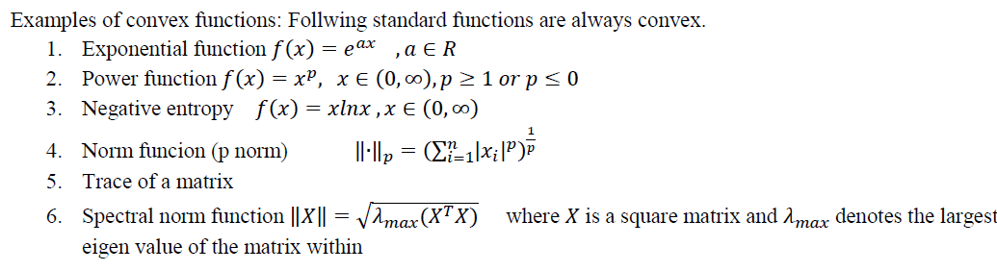
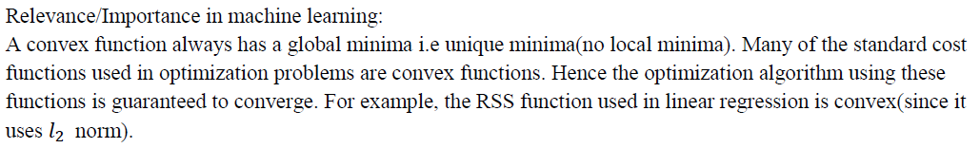
Convex Sets & Convex Functions
Concave functions: A function 𝑓 is concave function if −𝑓 is a convex function.

Slide 22
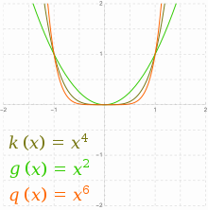
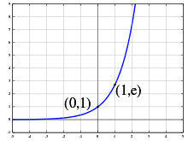
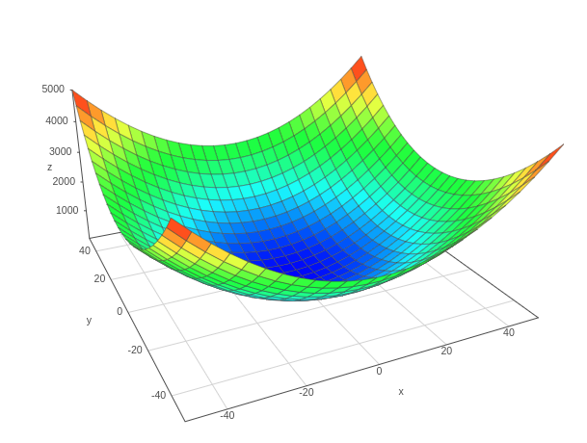
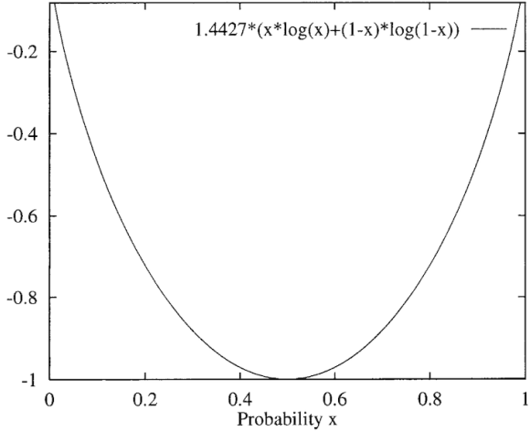
Convex Set - Illustrations
Exponential
Power
P Norm
Negative Entropy

Slide 23
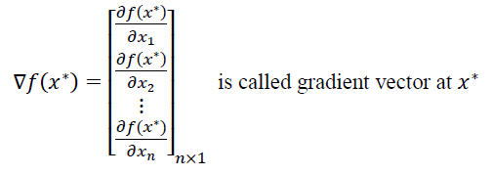
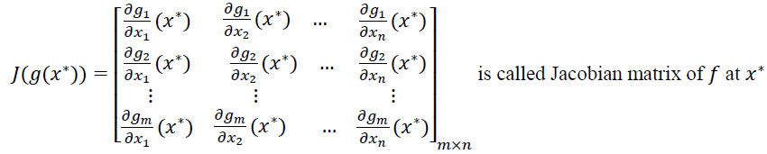
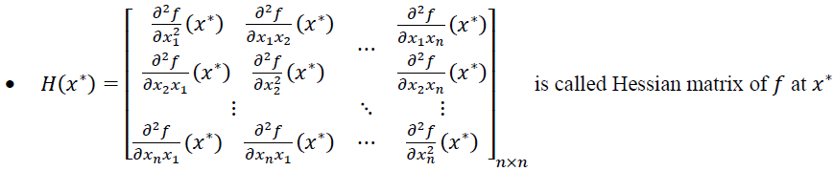
Gradient Vector, Jacobian Matrix & Hessian Matrix
𝑓:𝑅𝑛→𝑅 be a scalar valued function
𝑔:𝑅𝑛→𝑅𝑚 be a vector valued function.
If 𝑥∗=(𝑥₁,𝑥₂….𝑥_{𝑛}) ∈ 𝑆 for some open convex set 𝑆 in 𝑅_{𝑛} then
Gradient vector at any point x* represents a direction of maximum increase in the function f(x) and the rate of increase is the magnitude of the vector.
It contains a first-order partial derivative for a vector function
It contains second-order partial derivative for a vector function
It optimizes a given function.

Slide 24
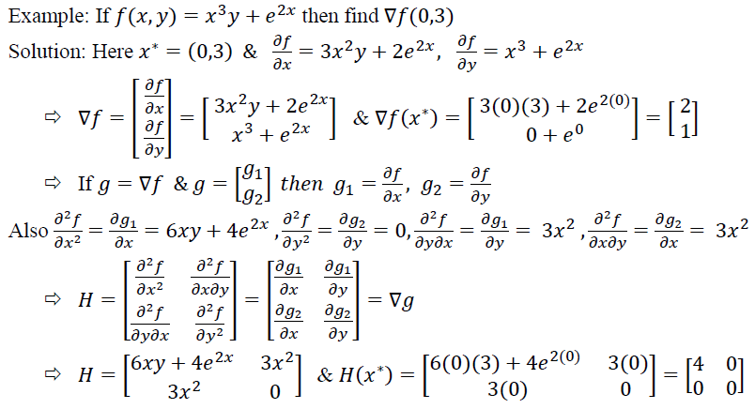
Gradient Vector, Jacobian Matrix & Hessian Matrix
𝑓:𝑅𝑛→𝑅 be a scalar valued function
𝑔:𝑅𝑛→𝑅𝑚 be a vector valued function.
If 𝑥∗=(𝑥₁,𝑥₂….𝑥_{𝑛}) ∈ 𝑆 for some open convex set 𝑆 in 𝑅_{𝑛} then
Hessian matrix is the Jacobian matrix of the gradient vector
𝐻(𝑓(𝑥))=𝐽(∇𝑓(𝑥)) , 𝑥∈𝑅𝑛

Slide 25
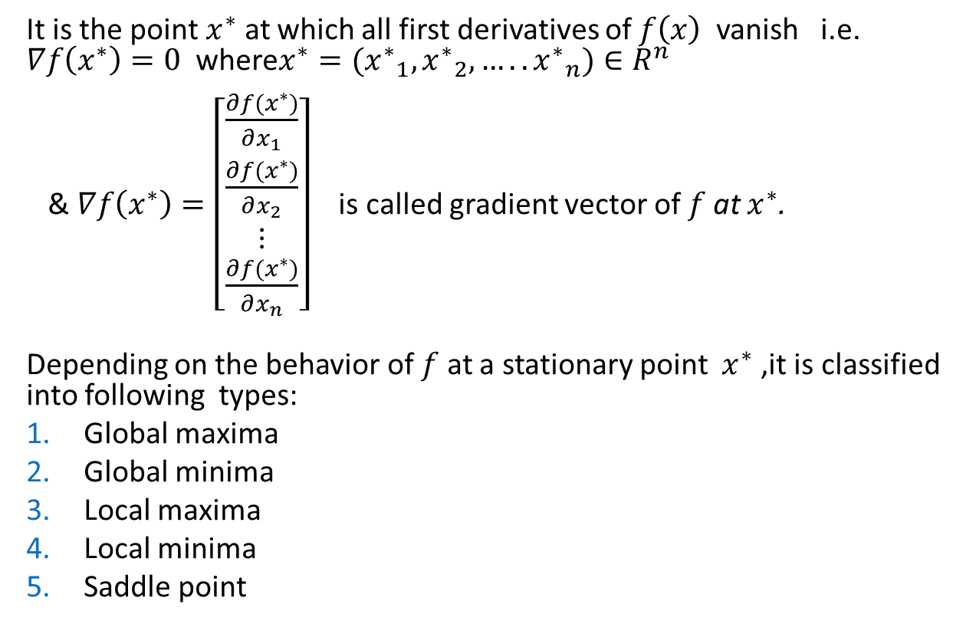
Stationary point
It is the point $x^{∗}$ at which all first derivatives of $f\left(x\right)$ vanish i.e. $∇f\left(x^{∗}\right)=0$ where$x^{∗}=({x^{∗}}_{1},{x^{∗}}_{2},…..{x^{∗}}_{n})∈R^{n}$
& $∇f\left(x^{∗}\right)=\left[\begin{matrix}\frac{∂f(x^{∗})}{∂x_{1}} \\ \frac{∂f(x^{∗})}{∂x_{2}} \\ \begin{matrix}⋮ \\ \frac{∂f(x^{∗})}{∂x_{n}}\end{matrix}\end{matrix}\right]$ is called gradient vector of $f$at $x^{∗}$.
Depending on the behavior of $f$ at a stationary point $x^{∗}$ ,it is classified into following types:
Global maxima
Global minima
Local maxima
Local minima
Saddle point

Slide 26
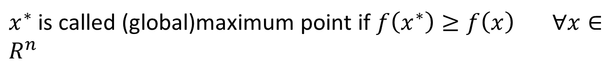


Global Maximum or maximum point:
${f(x}^{∗}$)
$$x^{∗}$$
$x^{∗}$ is called (global)maximum point if $f\left(x^{∗}\right)≥f\left(x\right) ∀x∈R^{n}$

Slide 27


Global Minimum or minimum point:
$x^{∗}$ is called (global)minimum point if $f\left(x^{∗}\right)≤f\left(x\right) ∀x∈R^{n}$
$$f(x_{∗})$$

Slide 28
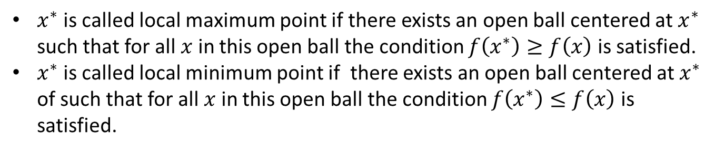
Relative Maximum & minimum point:
$x^{∗}$is called local maximum point if there exists an open ball centered at $x^{∗}$ such that for all $x$ in this open ball the condition $f\left(x^{∗}\right)≥f\left(x\right)$ is satisfied.
$x^{∗}$is called local minimum point if there exists an open ball centered at $x^{∗}$ of such that for all $x$ in this open ball the condition $f\left(x^{∗}\right)≤f\left(x\right)$ is satisfied.

Slide 29

Saddle point:
Saddle point
If $x^{∗}$ is neither (global/local)maximum nor (global/local)minimum is called a saddle point.

Slide 30
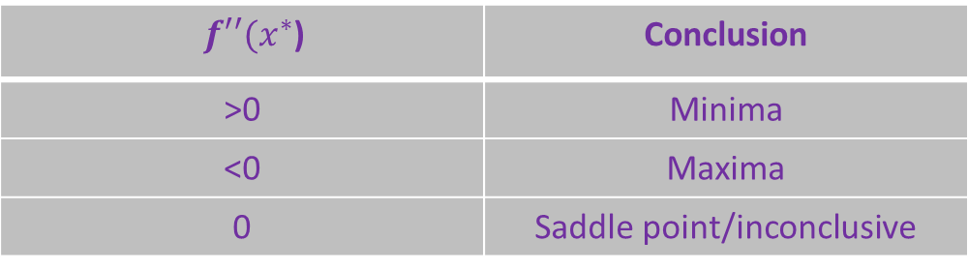
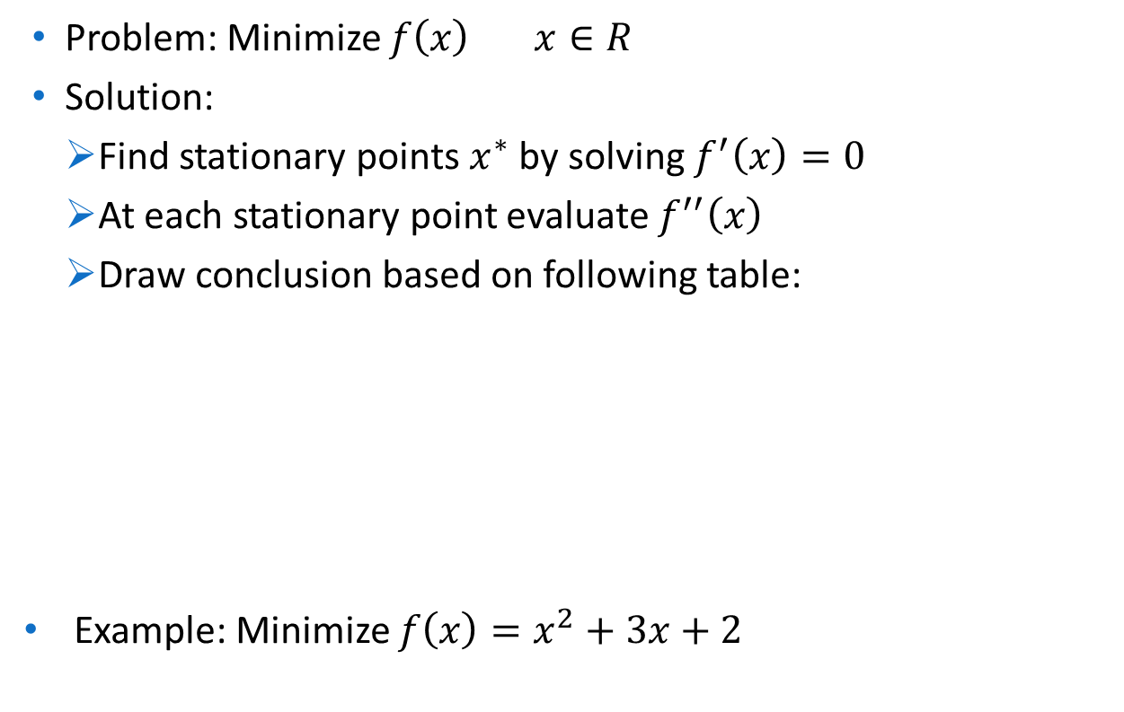
Optimization of function of one variable
Problem: Minimize $f\left(x\right) x∈R$
Solution:
Find stationary points $x^{∗}$ by solving $f^{′}\left(x\right)=0$
At each stationary point evaluate $f^{′′}\left(x\right)$
Draw conclusion based on following table:
Example: Minimize $f\left(x\right)=x^{2}+3x+2$
$f′′(x^{∗}$) | Conclusion
>0 | Minima
<0 | Maxima
0 | Saddle point/inconclusive

Slide 31
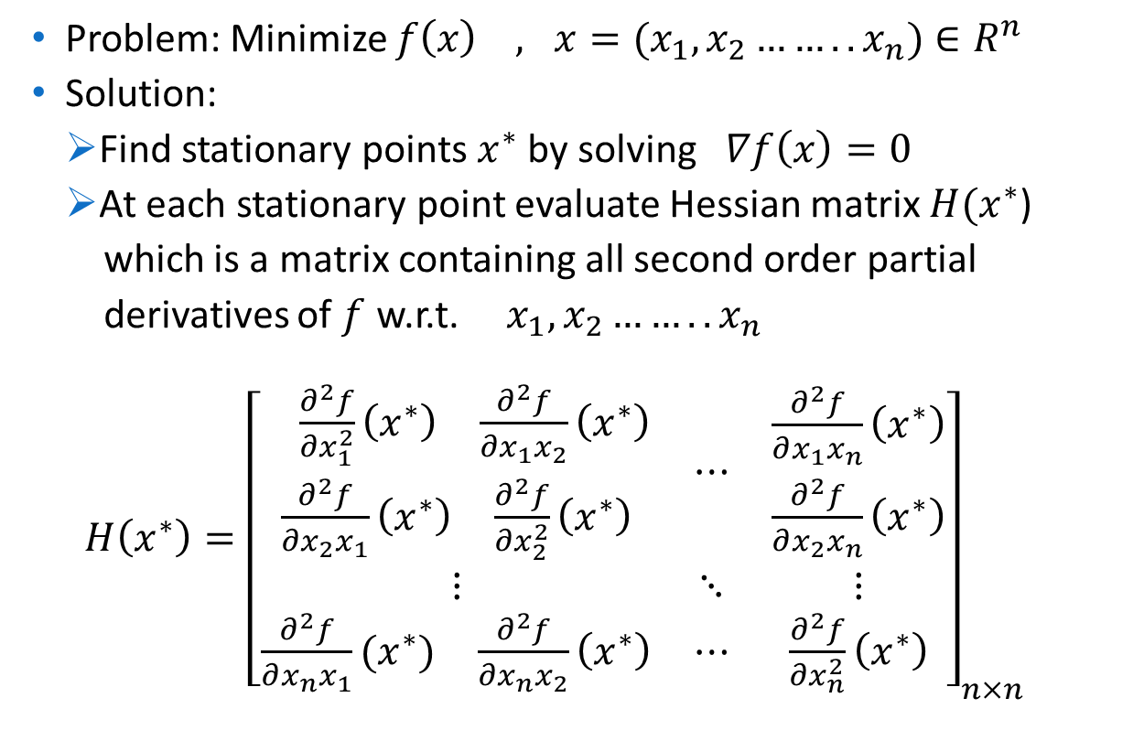
Optimization of function of more than two variables
Problem: Minimize $f\left(x\right) , x=(x_{1},x_{2}……..x_{n})∈R^{n}$
Solution:
Find stationary points $x^{∗}$ by solving$∇f\left(x\right)=0$
At each stationary point evaluate Hessian matrix $H(x^{∗}$)
which is a matrix containing all second order partial
derivatives of $f$ w.r.t. $x_{1},x_{2}……..x_{n}$
$H\left(x^{∗}\right)={\left[\begin{matrix}\begin{matrix}\begin{matrix} \frac{∂^{2}f}{∂x_{1}^{2}}\left(x^{∗}\right) & \frac{∂^{2}f}{∂x_{1}x_{2}}\left(x^{∗}\right)\end{matrix} \\ \begin{matrix}\frac{∂^{2}f}{∂x_{2}x_{1}}\left(x^{∗}\right) & \frac{∂^{2}f}{∂x_{2}^{2}}\left(x^{∗}\right)\end{matrix}\end{matrix} & ⋯ & \begin{matrix}\frac{∂^{2}f}{∂x_{1}x_{n}}\left(x^{∗}\right) \\ \frac{∂^{2}f}{∂x_{2}x_{n}}\left(x^{∗}\right)\end{matrix} \\ ⋮ & ⋱ & ⋮ \\ \begin{matrix}\frac{∂^{2}f}{∂x_{n}x_{1}}(x^{∗}) & \frac{∂^{2}f}{∂x_{n}x_{2}}\left(x^{∗}\right)\end{matrix} & ⋯ & \frac{∂^{2}f}{∂x_{n}^{2}}\left(x^{∗}\right)\end{matrix}\right]}_{n×n}$

Slide 32
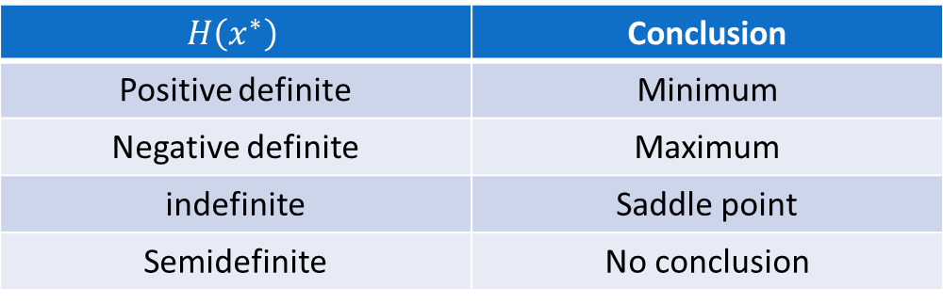
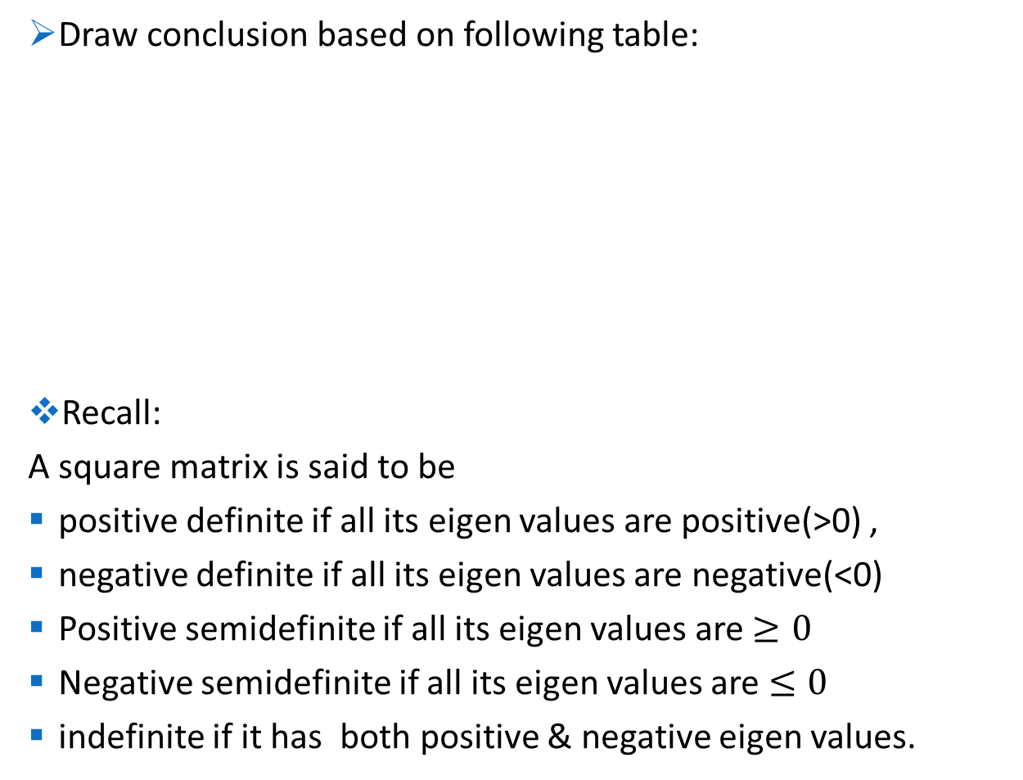
Draw conclusion based on following table:
Recall:
A square matrix is said to be
positive definite if all its eigen values are positive(>0) ,
negative definite if all its eigen values are negative(<0)
Positive semidefinite if all its eigen values are $≥0$
Negative semidefinite if all its eigen values are $≤0$
indefinite if it has both positive & negative eigen values.
$$H\left(x^{∗}\right)$$ | Conclusion
Positive definite | Minimum
Negative definite | Maximum
indefinite | Saddle point
Semidefinite | No conclusion

Slide 33
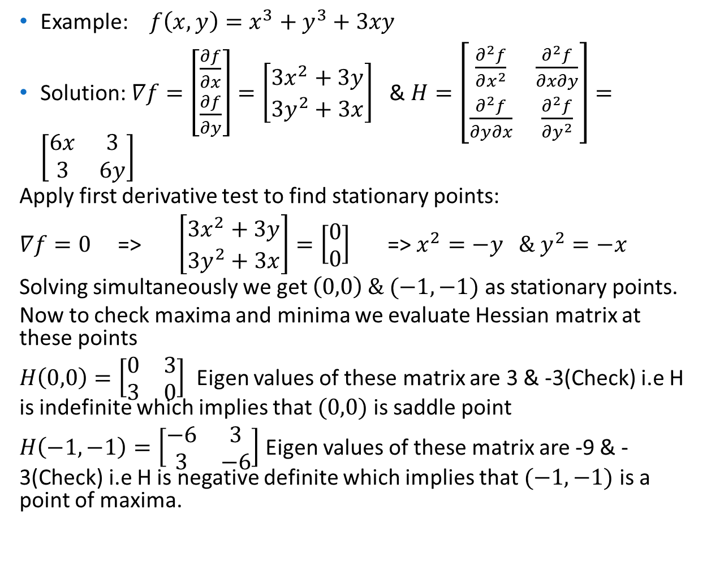
Example: $f\left(x,y\right)=x^{3}+y^{3}+3xy$
Solution: $∇f=\left[\begin{matrix}\frac{∂f}{∂x} \\ \frac{∂f}{∂y}\end{matrix}\right]=\left[\begin{matrix}3x^{2}+3y \\ 3y^{2}+3x\end{matrix}\right]$ & $H=\left[\begin{matrix}\frac{∂^{2}f}{∂x^{2}} & \frac{∂^{2}f}{∂x∂y} \\ \frac{∂^{2}f}{∂y∂x} & \frac{∂^{2}f}{∂y^{2}}\end{matrix}\right]=\left[\begin{matrix}6x & 3 \\ 3 & 6y\end{matrix}\right]$
Apply first derivative test to find stationary points:
$∇f=0$ => $\left[\begin{matrix}3x^{2}+3y \\ 3y^{2}+3x\end{matrix}\right]=\left[\begin{matrix}0 \\ 0\end{matrix}\right]$ => $x^{2}=−y \& y^{2}=−x$
Solving simultaneously we get $\left(0,0\right) \& (−1,−1)$ as stationary points.
Now to check maxima and minima we evaluate Hessian matrix at these points
$H\left(0,0\right)=\left[\begin{matrix}0 & 3 \\ 3 & 0\end{matrix}\right]$ Eigen values of these matrix are 3 & -3(Check) i.e H is indefinite which implies that $(0,0)$ is saddle point
$H\left(−1,−1\right)=\left[\begin{matrix}−6 & 3 \\ 3 & −6\end{matrix}\right]$ Eigen values of these matrix are -9 & -3(Check) i.e H is negative definite which implies that $(−1,−1)$ is a point of maxima.

Slide 34

Examples for practice:
$f\left(x,y\right)=x^{3}+3xy^{2}−15x^{2}−15y^{2}+72x$
$f\left(x,y\right)=3x^{2}+5y^{2}+5x+4y+5$
$f\left(x,y,z\right)=−9x^{2}+6xy−2y^{2}−2xz−2z^{2}$
$f\left(x,y,z\right)=3x^{2}+xz+2zy−z^{2}$

